Slide 1




HOME CREDIT DEFAULT RISK
GROUP 6
ADARSH FNU
CHARITH REDDY GOPAVARAM
DHEERAJ YATA

Slide 2

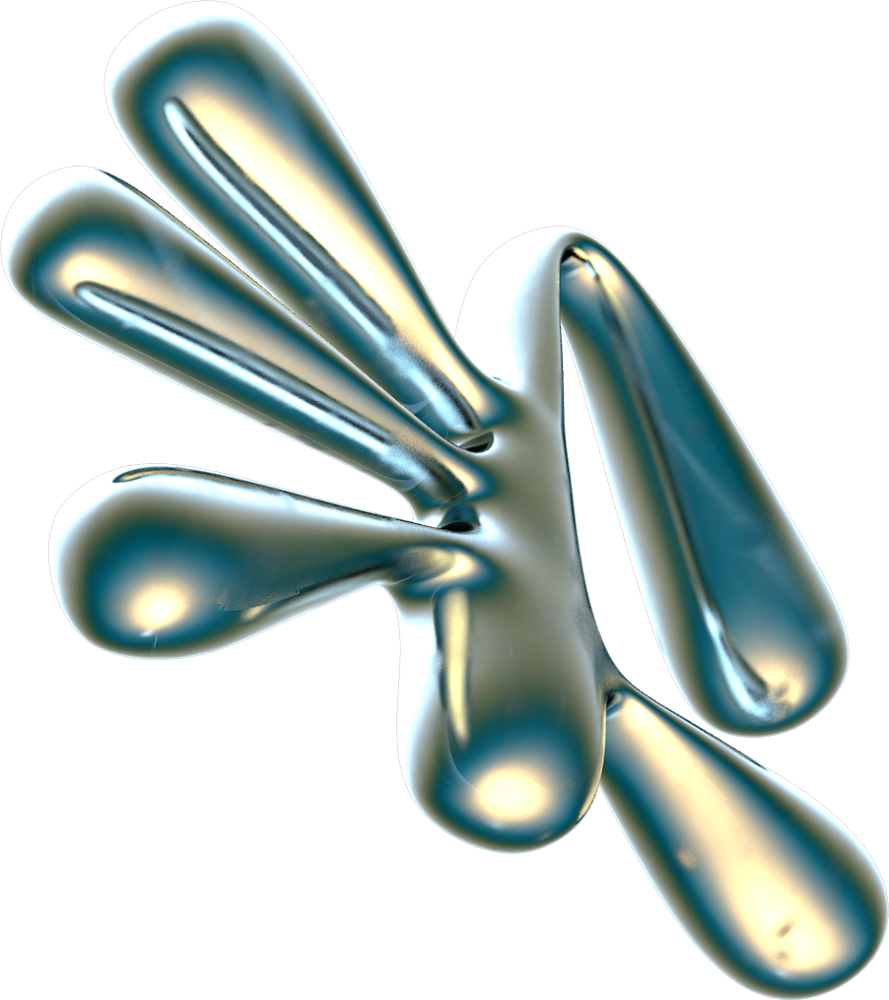
TABLE OF CONTENTS
01.
02.
Business Problem
Dataset Exploration
03.
04.
Modelling
Business Recommendations

Slide 3


BUSINESS PROBLEM

Slide 4
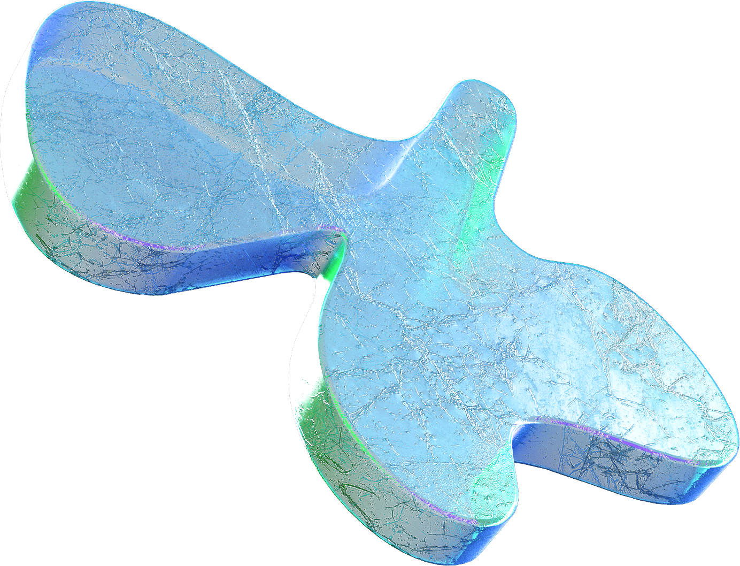


Non-Traditional Borrower’s
Risk of Untrustworthy Lenders
Utilizing Additional Data Sources
Enhancing Credit Worthiness

Slide 5

PROJECT
OBJECTIVES
TASK 1
TASK 2
TASK 3
TASK 4
TASK 5
Conduct In-Depth Data Exploration (EDA)
Implement and Tune Machine Learning Models
Evaluate Model Performance using ROC/AUC curve.
Feature Importance and Kaggle Score
Business Recommendations

Slide 6
DATASET
EXPLORATION

Slide 7

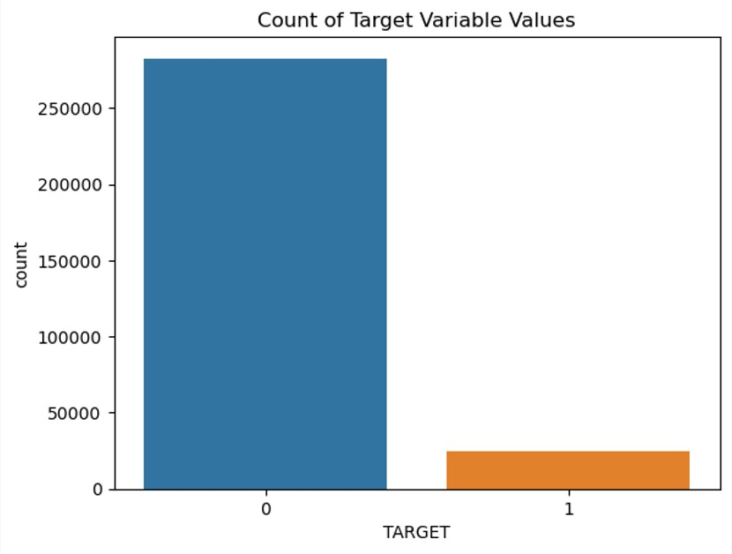
DATA-SET
DIMENSIONS
Number of Features: 122
Number of Observations: 307,511
IMBALANCED TARGET VARIABLE
More loans were repaid than loans that were not repaid

Slide 8
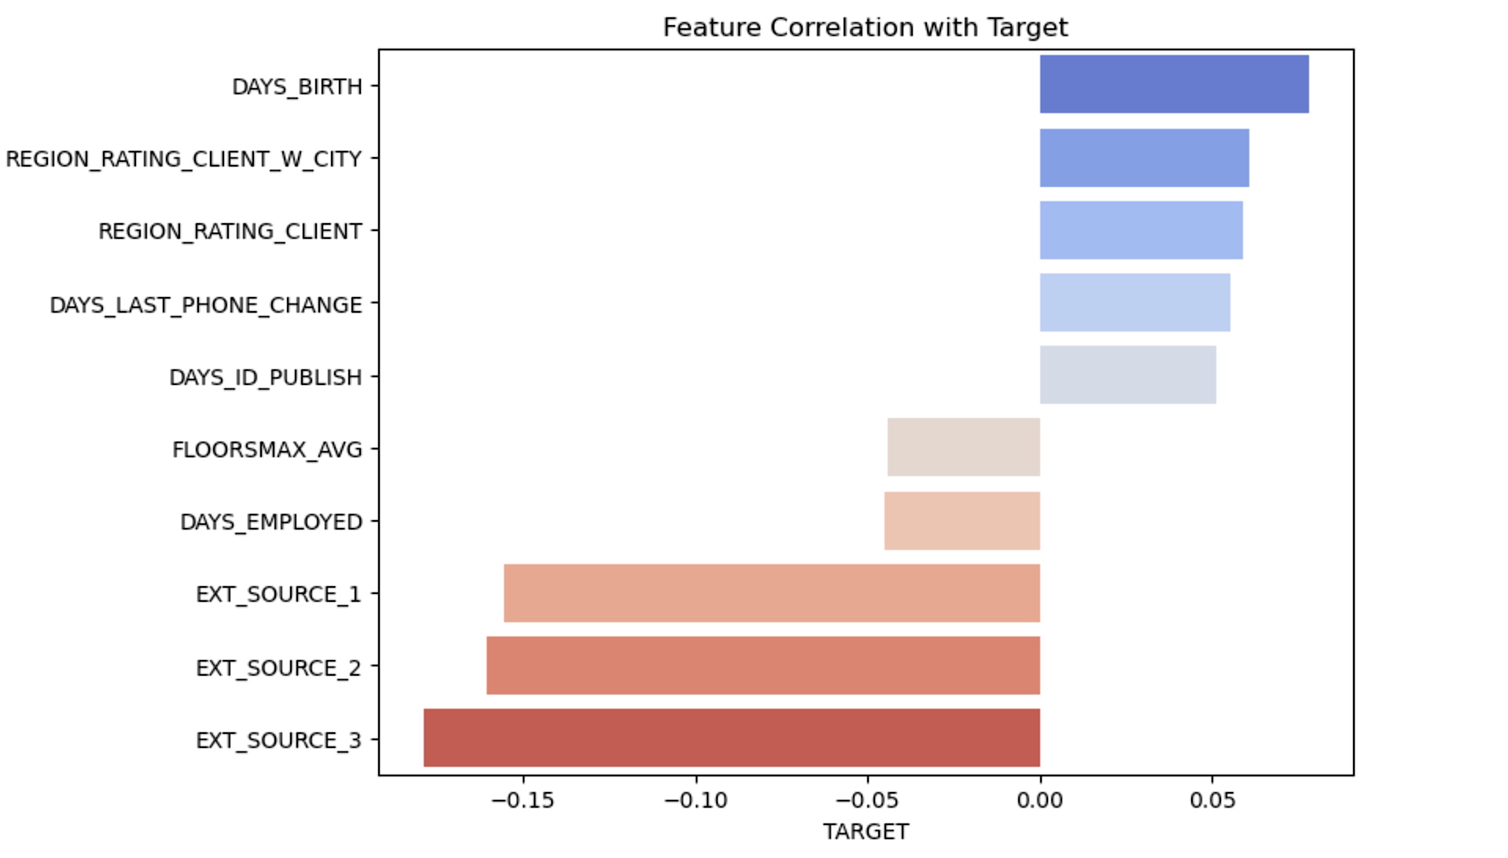
CORRELATION

Slide 9
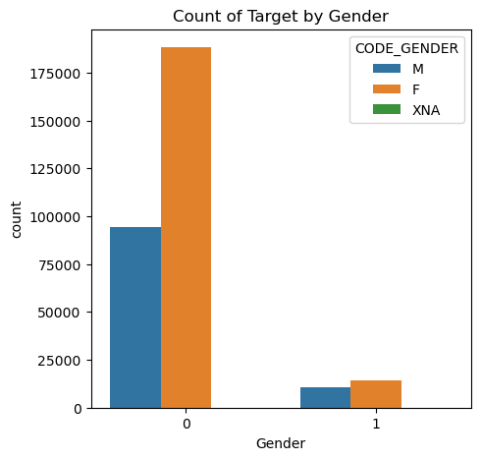
INSIGHTS FROM EDA
GENDER ROLE
Loan Repayment Trend
More loans were repaid by female’s than male’s

Slide 10

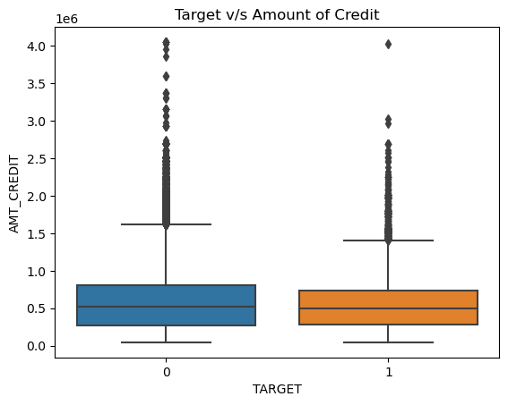
INSIGHTS FROM EDA
Loan Repayment
v/s
Amount of Credit
Customer’s with the greater proportion of loan credit amount have repaid their loans.

Slide 11
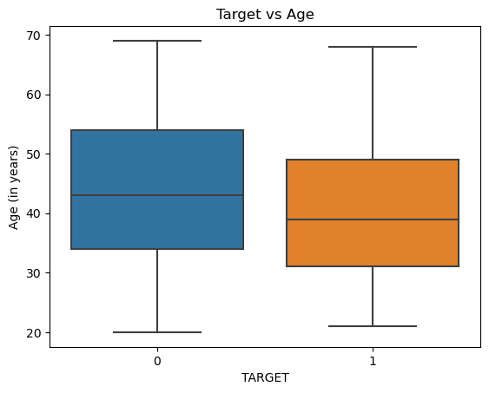
INSIGHTS FROM EDA
Loan Repayment
v/s
Age
Loan Repayment Trend
Older age tends to mean fewer loan defaults, suggesting age is a good indicator of repayment reliability.

Slide 12
MISSING VALUES
Imputation Strategy
Column
Imbalance
Dropped Columns with 48% missing values, excluding external source 1.
Object Type: Mode
Numeric Type: Median.
There was Low Variability when 21 columns were dropped.
HIGH LEVEL PRE-PROCESSING

Slide 13

FEATURE ENGINEERING
1.
2.
3.
4.
5.
AGE_YEARS
YEARS_EMPLOYED
ANNUITY_INCOME_PERCENT
CREDIT_TERM
INCOME_CREDIT_RATIO
Calculated age of each person in years based on the number of days since birth.
Calculated employment duration of each person in years.
Calculates the percentage of each person's income used for paying the annuity.
Calculates the percentage of the ratio between a total annuity payment and total credit amount
Calculates the percentage of ratio between applicant's total income and total credit amount

Slide 14

MODELLING

Slide 15
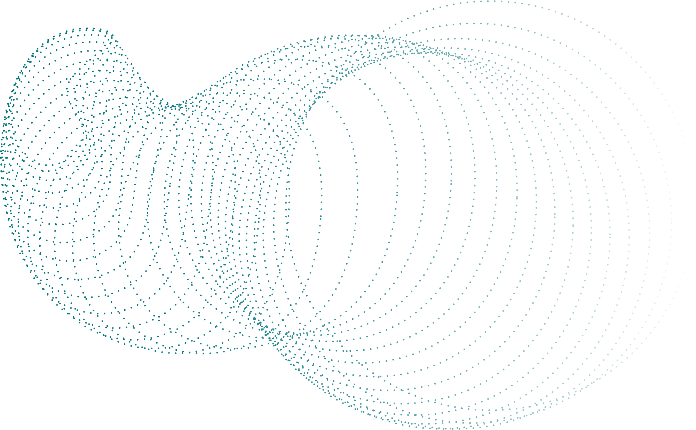
MODEL BUILDING
MODEL SELECTION
MODEL EVALUATION
HANDLING IMBALANCED DATA
FEATURE SELECTION
Scores
Scores
Scores
.

Slide 16
MODELLING TECHNIQUES
LOGISTIC REGRESSION
RANDOM FOREST
LIGHT GBM
It is suitable for binary classification tasks, and in the current data, the target variable is categorical data, which has "yes" or "no" binary choices.
Random forests can enhance prediction accuracy by efficiently gathering complex patterns and feature relationships.
Light GBM excels with big data, offering speed and accuracy through gradient-based sampling and feature bundling.
Scores
Scores
Scores
Kaggle Score: 0.567
Accuracy: 0.68
AUC: 0.737
Kaggle Score: 0.63
Accuracy: 0.91
AUC: 0.738
Kaggle Score: 0.63
Accuracy:0.92
AUC: 0.76
.

Slide 17
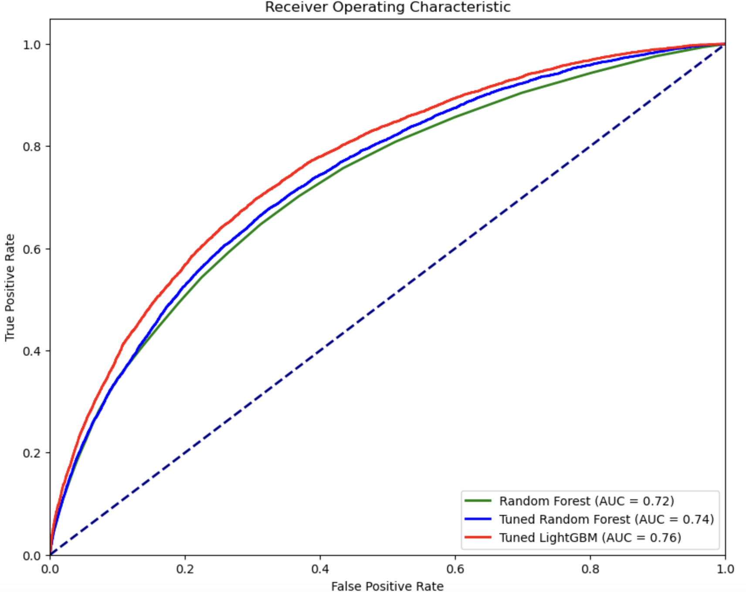
ROC-AUC CURVE

Slide 18
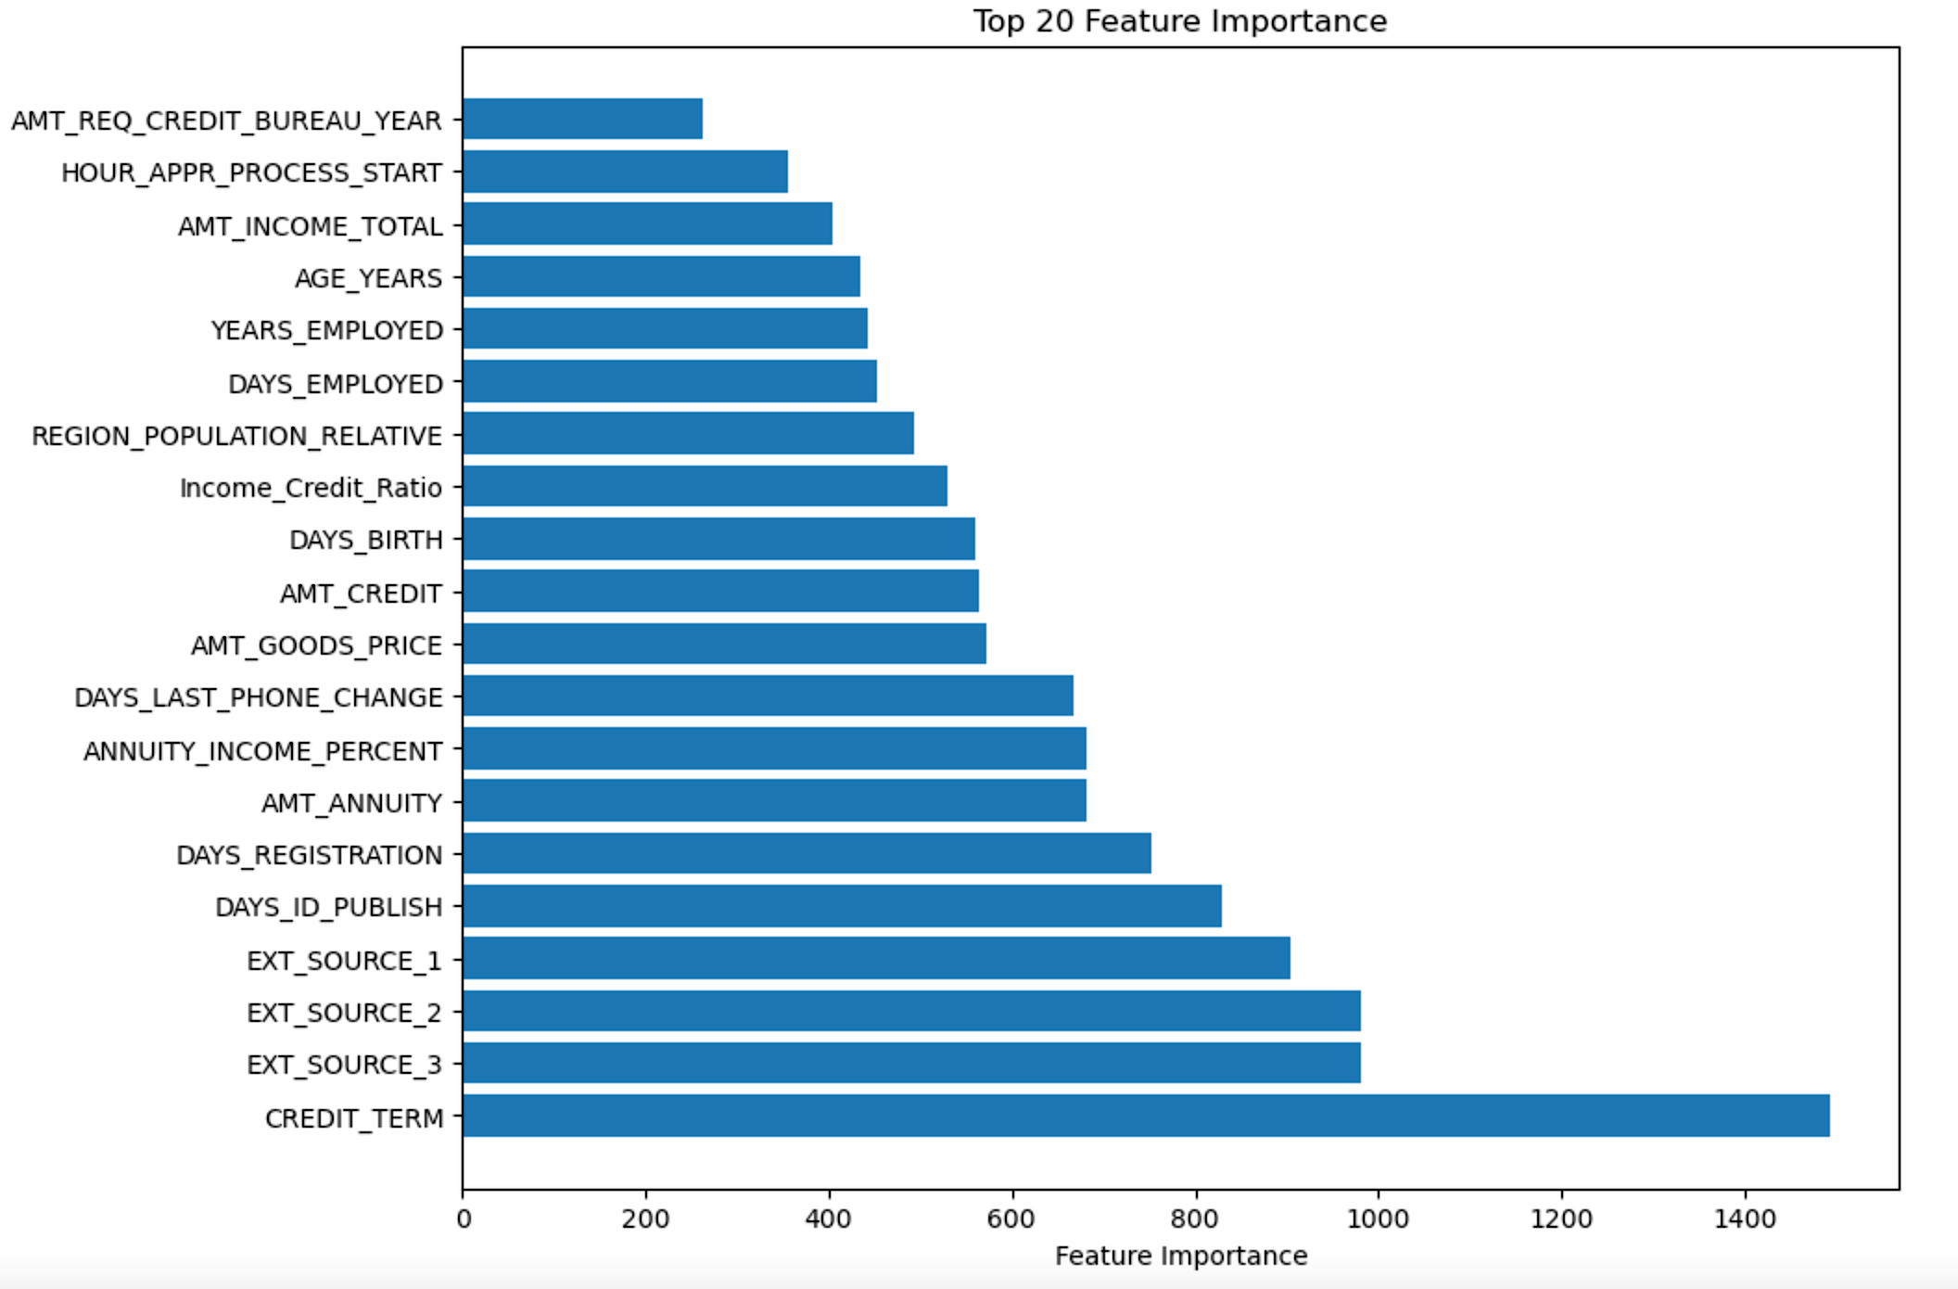
FEATURE IMPORTANCE

Slide 19
BUSINESS RECOMMENDATIONS
Prioritize Loan
Approvals
Implement Regular Model Retraining
Develop Targeted Loan Products
Focusing on high-quality applicant profiles to streamline the approval process efficiently.
Speed up the loan approval process through automation.
Ensuring model accuracy and effectiveness through consistent updates and refinements for reliable risk assessment.
Creating specialized loan offerings to cater to diverse customer segments like students, improving market competitiveness.
Scores
Scores

Slide 20
THANK YOU

Slide 21

Q & A

